Slide 1
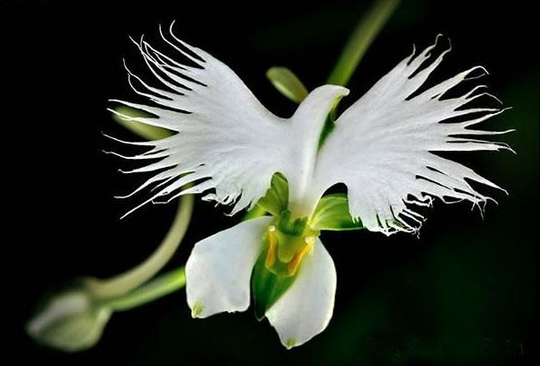
Welcome to St. Luke’s Parish Lalor
‘Please respect the silence of those who pray’

Slide 2
ENTRANCE SONGS

Slide 3
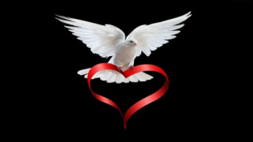
C: In the name of the Father, and of the Son and of the Holy Spirit.
A: Amen
C: The grace of our Lord Jesus Christ, and the love of God, and the communion of the Holy Spirit be with you all.
A: And with your Spirit

Slide 4
PENITENTIAL ACT
I confess to Almighty God
And to you, my brothers and sisters,
That I have greatly sinned, in my
thoughts and in my words, In what I have done and in what have failed to do,
Through my fault, through my fault,
Through my most grievous fault;
1 of 2

Slide 5
2 of 2
Therefore I ask blessed Mary ever Virgin,
All the Angels and Saints,
And you, my brothers and sisters,
To pray for me to the Lord our God.

Slide 6
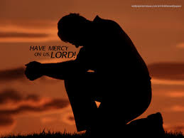
C- Lord have mercy
A- Lord have mercy
C - Christ have mercy
A - Christ have mercy
C- Lord have mercy
A- Lord have mercy

Slide 7
1 of 3
GLORY TO GOD
Glory to God in the highest
And on earth peace to people of good will
We praise You, we bless You,
We adore You, we glorify You,
We give You thanks for Your great glory.
Lord God heavenly King,
O God almighty Father.

Slide 8
2 of 3
Lord Jesus Christ, Only Begotten Son.
Lord God, Lamb of God, Son of the Father,
you take away the sins of the world,
Have mercy on us;
you take away the sins of the world,
receive our prayer;

Slide 9
3 of 3
You are seated at the right hand of the Father,
Have mercy on us.
For You alone are the Holy One,
You alone are the Lord,
You alone are the Most High, Jesus Christ,
with the Holy Spirit, in the glory of God the Father. Amen….

Slide 10
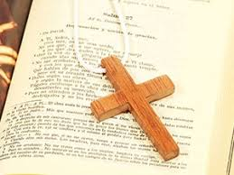

Slide 11
Liturgy of the Word
1 of 2
First Reading Nehemiah 8:2-6. 8-10
A reading from the book of Nehemiah
Ezra the priest brought the Law before the assembly, consisting of men, women, and children old enough to understand. This was the first day of the seventh month. On the square before the Water Gate, , in the presence of the men and women, and children old enough to understand,

Slide 12
2 of 2
he read from the book from early morning till noon; all the people listened attentively to the Book of the Law.
Ezra the scribe stood on a wooden dais erected for the purpose. In full view of all the people – since he stood higher than all the people – Ezra opened the book; and when he opened it all the people stood up.

Slide 13
2 of 2
Then Ezra blessed the Lord, the great God, and all the people raised their hands and answered Amen! Amen!; then they bowed down and, face to the ground, prostrated themselves before the Lord. And Ezra read from the Law of God, translating and giving the sense, so that the people understood what was read.

Slide 14
2 of 2
Then Nehemiah – His Excellency – and Ezra, priest and scribe (and the Levites who were instructing the people) said to all the people, ‘This day is sacred to the Lord your God. Do not be mournful, do not weep’. For the people were all in tears as they listened to the words of the Law.

Slide 15
2 of 2
‘He then said, ‘Go, eat the fat, drink the sweet wine, and send a portion to the man who has nothing prepared ready. For this day is sacred to our Lord. Do not be sad: the joy of the Lord is your stronghold.’
The Word of the Lord.
A: Thanks be to God

Slide 16
Responsorial Psalm
Ps 146:1-6. R. v.3
(R.) Your words, Lord, are spirit and life.
1.The law of the Lord is perfect,
it revives the soul.
The rule of the Lord is to be trusted,
it gives wisdom to the simple. (R.)

Slide 17
(R.) Your words, Lord, are spirit and life.
2.The precepts of the Lord are right,
they gladden the heart.
The command of the Lord is clear,
it gives light to the eyes. (R.)
3. The fear of the Lord is holy,
abiding for ever. The decrees of the Lord are truth and all of them just. (R.)

Slide 18
4. May the spoken words of my mouth,
the thoughts of my heart,
win favour in your sight, O Lord,
my rescuer, my rock! (R.)
(R.) Your words, Lord, are spirit and life.

Slide 19
Second ReadingA reading from the first letter
of St Paul to the Corinthians Corinthians 12:12-30
Just as a human body, though it is made up of many parts, is a single unit because all these parts, though many, make one body, so it is with Christ. In the one Spirit we were all baptised, Jews as well as Greeks, slaves as well as citizens, and one Spirit was given to us all to drink.

Slide 20
Nor is the body to be identified with any one of its many parts. If the foot were to say, ‘I am not a hand and so I do not belong to the body’, would that mean that it stopped being part of the body? If the ear were to say, ‘I am not an eye, and so I do not belong to the body,’ would that mean that it is not a part of the body?

Slide 21
If your whole body was just one eye, how would you hear anything? If it was just one ear, how would you smell anything?
Instead of that, God put all the separate parts into the body on purpose. If all the parts were the same, how could it be a body? As it is, the parts are many but the body is one. The eye cannot say to the hand,

Slide 22
‘I do not need you,’ nor can the head say to the feet, ‘I do not need you.’
What is more, it is precisely the parts of the body that seem to be the weakest which are the indispensable ones; and it is the least honourable parts of the body that we clothe with the greatest care. So our more improper parts get decorated in a way that our more proper parts do not need.

Slide 23
God has arranged the body so that more dignity is given to the parts which are without it, and so that there may not be disagreements inside the body, but that each part may be equally concerned for all the others. If one part is hurt, all parts are hurt with it. If one part is given special honour, all parts enjoy it.
Now you together are Christ’s body;

Slide 24
but each of you is a different part of it. In the Church, God has given the first place to apostles, the second to prophets, the third to teachers; after them, miracles, and after them the gift of healing; helpers, good leaders, those with many languages. Are all of them apostles,

Slide 25
or all of them prophets, or all of them teachers? Do they all have the gift of miracles, or all have the gift of healing? Do all speak strange languages, and all interpret them?
The Word of the Lord.
A: Thanks be to God

Slide 26
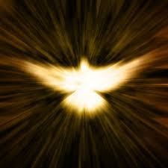
Gospel Acclamation
Alleluia, alleluia!
The Lord sent me to bring Good News to the poor and freedom to prisoners.
Alleluia

Slide 27
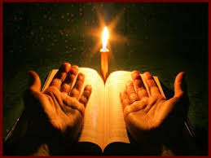
C: The Lord be with you.
A: And with your spirit
C: A reading from the holy Gospel according to Luke
A: Glory to you Lord

Slide 28
Gospel : Luke 1:1-4. 4:14-21
Seeing that many others have undertaken to draw up accounts of the events that have taken place among us, exactly as these were handed down to us by those who from the outset were eyewitnesses and ministers of the word, I in my turn, after carefully going over the whole story from the beginning,

Slide 29
have decided to write an ordered account for you, Theophilus, so that your Excellency may learn how well founded the teaching is that you have received. Jesus, with the power of the Spirit in him, returned to Galilee; and his reputation spread throughout the countryside. He taught in their synagogues and everyone praised him. He came to Nazara,

Slide 30
where he had been brought up, and went into the synagogue on the sabbath day as he usually did. He stood up to read, and they handed him the scroll of the prophet Isaiah. Unrolling the scroll he found the place where it is written: The spirit of the Lord has been given to me, for he has anointed me.

Slide 31
He has sent me to bring the good news to the poor, to proclaim liberty to captives and to the blind new sight, to set the downtrodden free, to proclaim the Lord’s year of favour. He then rolled up the scroll, gave it back to the assistant and sat down.

Slide 32
. And all eyes in the synagogue were fixed on him. Then he began to speak to them, ‘This text is being fulfilled today even as you listen.’
The Gospel of the Lord.
Praise to you, Lord Jesus Christ

Slide 33
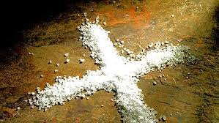

Slide 34
1 of 3
Nicene Creed
I believe in one God,
the Father almighty,
maker of heaven and earth,
of all things visible and invisible.
I believe in one Lord, Jesus Christ,
the Only Begotten Son of God,
born of the Father before all ages.

Slide 35
God from God, Light from Light,
true God from true God,
begotten, not made, consubstantial with the Father; through Him all things were made. For us men and for our salvation.
He came down from heaven,
and by the Holy Spirit was incarnate of the Virgin Mary, and became man.

Slide 36
For our sake He was crucified under Pontius Pilate,
He suffered death and was buried,
and rose again on the third day
In accordance with the Scriptures.
He ascended into heaven
and is seated at the right hand of the Father.

Slide 37
He will come again in glory
to judge the living and the dead, and His Kingdom will have no end.
I believe in the Holy Spirit, the Lord, the giver of life,
who proceeds from the Father and the Son, who with the Father and the Son is adored and glorified,
who has spoken through the prophets.

Slide 38
I believe in one, Holy, Catholic and Apostolic Church. I confess one Baptism for the forgiveness of sins and I look forward to the resurrection of the dead, and the life of the world to come. Amen.

Slide 39
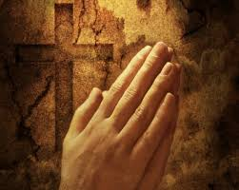
Reader: We pray for…
Let us pray to the Lord.
People: Lord hear our prayer.

Slide 40
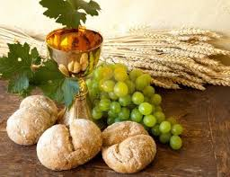

Slide 41
OFFERTORY SONGS

Slide 42
The Liturgy of the Eucharist
C: Pray, brethren that my sacrifice and yours may be acceptable to God, the almighty Father.
A: May the Lord accept the sacrifice at your hands for the praise and glory of his name, for our good the good of all his holy Church. Amen.

Slide 43
The Eucharistic Prayer
C: The Lord be with you.
A: And with your spirit.
C: Lift up your hearts.
A: Lift them up to the Lord.
C: Let us give thanks to the Lord our God.
A: It is right and just.

Slide 44
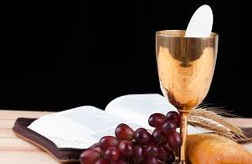

Slide 45
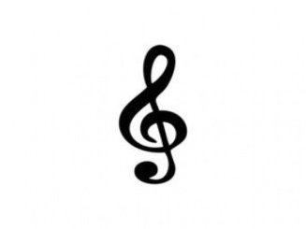
SANCTUS
Holy, holy, holy Lord God of hosts.
Heaven and earth are full of your glory
Hosanna in the highest,
blessed is he who comes in the name of the Lord Hosanna in the highest…

Slide 46
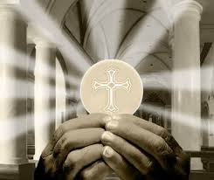

Slide 47
MYSTERY OF FAITH
We proclaim your death O Lord
And profess your resurrection
Until you come again…

Slide 48
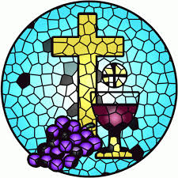

Slide 49
1 of 2
LORD’S PRAYER
Our Father, who art in heaven
Hallowed be Thy name.
Thy Kingdom come, Thy will be done
On earth as it is in Heaven
Give us this day our daily bread.
And forgive us our trespasses,
as we forgive those who trespass against us,

Slide 50
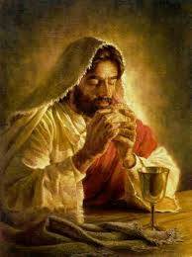
2 of 2
And lead us not into temptation,
But deliver us from evil.
For thy Kingdom, the Power and the Glory are Yours
Now and forever.

Slide 51
C: Lord Jesus Christ, who said to your Apostles…..
….Who live and reign for ever and ever
A: Amen
C: The peace of the Lord be with you always.
A: And with your spirit.

Slide 52
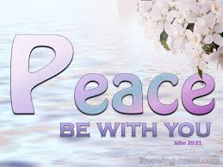

Slide 53
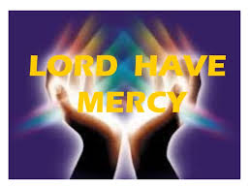
Lamb of God
Lamb of God, you take away the sins of the world,
Have mercy on us.
Lamb of God, you take away the sins of the world,
Have mercy on us.
Lamb of God, you take away the sins of the world, Grant us peace…

Slide 54
C: Behold the Lamb of God, behold him who takes away the sins of the world. Blessed are those called to the supper of the lamb.
A: Lord, I am not worthy that you should enter under my roof, but only say the word and my soul shall be healed.

Slide 55
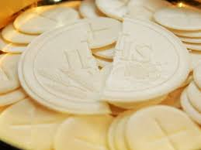

Slide 56
COMMUNION SONGS

Slide 57
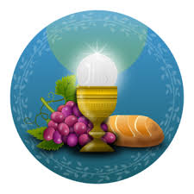

Slide 58
CONCLUDING RITES
C: The Lord be with you.
A : And with your spirit
C: May Almighty God Bless Us, Father and Son and Holy Spirit
A: Amen.
C: Go in Peace, glorifying the Lord by your life.
A: Thanks be to God.
.

Slide 59
FINAL SONGS

