Slide 1
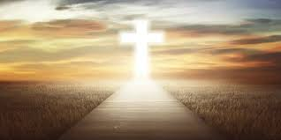
Welcome to St. Luke’s Parish Lalor
‘Please respect the silence of those who pray’

Slide 2
ENTRANCE SONGS

Slide 3

C: In the name of the Father, and of the Son and of the Holy Spirit.
A: Amen
C: The grace of our Lord Jesus Christ, and the love of God, and the communion of the Holy Spirit be with you all.
A: And with your Spirit

Slide 4
PENITENTIAL ACT
I confess to Almighty God
And to you, my brothers and sisters,
That I have greatly sinned, in my
thoughts and
in my words, In what I have done and in what have failed to do,
Through my fault, through my fault,
Through my most grievous fault;
1 of 2

Slide 5
2 of 2
Therefore I ask blessed Mary ever Virgin,
All the Angels and Saints,
And you, my brothers and sisters,
To pray for me to the Lord our God.

Slide 6

C- Lord have mercy
A- Lord have mercy
C - Christ have mercy
A - Christ have mercy
C- Lord have mercy
A- Lord have mercy

Slide 7

1 of 3
GLORY TO GOD
Glory to God in the highest
And on earth peace to people of good will
We praise You, we bless You,
We adore You, we glorify You,
We give You thanks for Your great glory.
Lord God heavenly King,
O God almighty Father.

Slide 8
2 of 3
Lord Jesus Christ, Only Begotten Son.
Lord God, Lamb of God, Son of the Father,
you take away the sins of the world,
Have mercy on us;
you take away the sins of the world,
receive our prayer;

Slide 9
3 of 3
You are seated at the right hand of the Father,
Have mercy on us.
For You alone are the Holy One,
You alone are the Lord,
You alone are the Most High, Jesus Christ,
with the Holy Spirit, in the glory of God the Father. Amen….

Slide 10
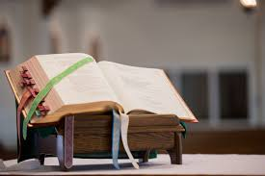

Slide 11
1 of 2
Liturgy of the Word
First Reading Ex 34:4-6. 8-9
A reading from the book of Exodus
With the two tablets of stone in his hands, Moses went up the mountain of Sinai in the early morning as the Lord had commanded him. And the Lord descended in the form of a cloud, and Moses stood with him there. He called on the name of the Lord. The Lord passed before him and proclaimed, ‘Lord, Lord,

Slide 12
2 of 2
a God of tenderness and compassion, slow to anger, rich in kindness and faithfulness.’ And Moses bowed down to the ground at once and worshipped. ‘If I have indeed won your favour, Lord,’ he said, ‘let my Lord come with us, I beg. True, they are a headstrong people, but forgive us our faults and our sins, and adopt us as your heritage.’
The Word of the Lord.
A: Thanks be to God

Slide 13

1 of 2
Responsorial Psalm
Ps 46:2-3. 6-7. 8-9. R. v.6
(R.) Glory and praise for ever!
1. You are blest, Lord God of our fathers.
Blest your glorious holy name.(R.)

Slide 14
2 of 2
(R.) Glory and praise for ever!
2. You are blest in the temple of your glory. (R.)
You are blest on the throne of your kingdom. (R.)
3. You are blest who gaze into the depths. (R.)
You are blest in the firmament of heaven. (R.)

Slide 15
Second Reading 1 2 Cor 13:11-13
A reading from
the letter of St Paul to the Corinthians
1 of 2
Brothers, we wish you happiness; try to grow perfect; help one another. Be united; live in peace, and the God of love and peace will be with you.
Greet one another with the holy kiss. All the saints send you greetings.

Slide 16
2 of 2
The grace of the Lord Jesus Christ, the love of God and the fellowship of the Holy Spirit be with you all.
he
The Word of the Lord.
A: Thanks be to God

Slide 17
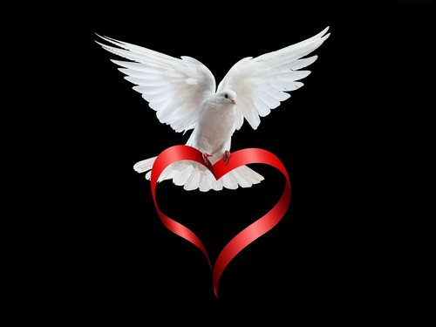
Gospel Acclamation
Alleluia, alleluia!
Glory to the Father, the Son, and the Holy Spirit: to God who is, who was, and who is to come.
Alleluia

Slide 18

C: The Lord be with you.
A: And with your spirit
C: A reading from the holy Gospel according to John
A: Glory to you Lord

Slide 19
1 of 2
Gospel: Jn 3:16-18
Jesus said to Nicodemus, ‘God loved the world so much that he gave his only Son, so that everyone who believes in him may not be lost but may have eternal life. For God sent his Son into the world not to condemn the world, but so that through him the world might be saved.

Slide 20
2 of 2
No one who believes in him will be condemned; but whoever refuses to believe is condemned already, because he has refused to believe in the name of God’s only Son.’
The Gospel of the Lord.
Praise to you, Lord Jesus Christ

Slide 21
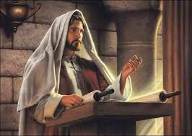

Slide 22
1 of 3
Nicene Creed
I believe in one God,
the Father almighty,
maker of heaven and earth,
of all things visible and invisible.
I believe in one Lord, Jesus Christ,
the Only Begotten Son of God,
born of the Father before all ages.
God from God, Light from Light,
true God from true God,
begotten, not made, consubstantial with the Father; through Him all things were made.

Slide 23
2 of 3
For us men and for our salvation.
He came down from heaven,
and by the Holy Spirit was incarnate of the Virgin Mary, and became man.
For our sake He was crucified under Pontius Pilate,
He suffered death and was buried,
and rose again on the third day
In accordance with the Scriptures.
He ascended into heaven
and is seated at the right hand of the Father.

Slide 24
He will come again in glory
to judge the living and the dead, and His Kingdom will have no end.
I believe in the Holy Spirit, the Lord, the giver of life,
who proceeds from the Father and the Son, who with the Father and the Son is adored and glorified,
who has spoken through the prophets.
I believe in one, Holy, Catholic and Apostolic Church. I confess one Baptism for the forgiveness of sins and I look forward to the resurrection of the dead, and the life of the world to come. Amen.

Slide 25
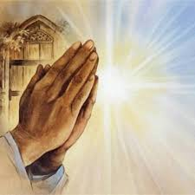
Reader: We pray for…
Let us pray to the Lord.
People: Lord hear our prayer.

Slide 26
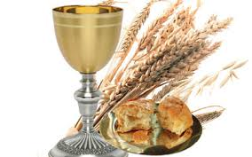

Slide 27
OFFERTORY SONGS

Slide 28
The Liturgy of the Eucharist
C: Pray, brethren that my sacrifice and yours may be acceptable to God, the almighty Father.
A: May the Lord accept the sacrifice at your hands for the praise and glory of his name, for our good the good of all his holy Church. Amen.

Slide 29
The Eucharistic Prayer
C: The Lord be with you.
A: And with your spirit.
C: Lift up your hearts.
A: Lift them up to the Lord.
C: Let us give thanks to the Lord our God.
A: It is right and just.

Slide 30
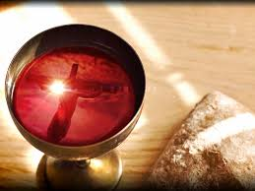

Slide 31

SANCTUS
Holy, holy, holy Lord God of hosts.
Heaven and earth are full of your glory
Hosanna in the highest,
blessed is he who comes in the name of the Lord
Hosanna in the highest…

Slide 32
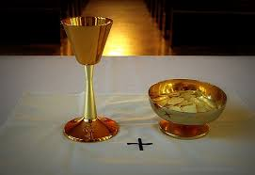

Slide 33
MYSTERY OF FAITH
We proclaim your death O Lord
And profess your resurrection
Until you come again…

Slide 34
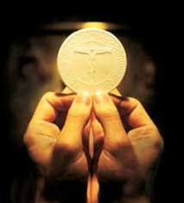

Slide 35

1 of 2
LORD’S PRAYER
Our Father, who art in heaven
Hallowed be Thy name.
Thy Kingdom come, Thy will be done
On earth as it is in Heaven
Give us this day our daily bread.
And forgive us our trespasses,
as we forgive those who trespass against us,
And lead us not into temptation,
But deliver us from evil.

Slide 36
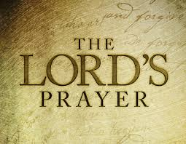
2 of 2
For thy Kingdom, the Power and the Glory are Yours
Now and forever.

Slide 37
C: Lord Jesus Christ, who said to your Apostles…..
….Who live and reign for ever and ever
A: Amen
C: The peace of the Lord be with you always.
A: And with your spirit.

Slide 38
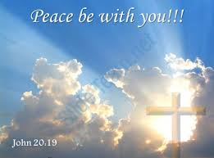

Slide 39
Lamb of God
Lamb of God, you take away the sins of the world,
Have mercy on us.
Lamb of God, you take away the sins of the world,
Have mercy on us.
Lamb of God, you take away the sins of the world,
Grant us peace…

Slide 40
C: Behold the Lamb of God, behold him who takes away the sins of the world. Blessed are those called to the supper of the lamb.
A: Lord, I am not worthy that you should enter under my roof, but only say the word and my soul shall be healed.

Slide 41
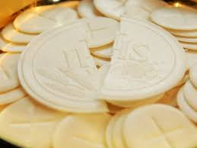

Slide 42
COMMUNION SONGS

Slide 43
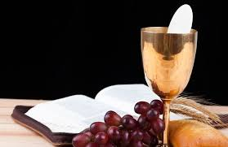

Slide 44
CONCLUDING RITES
C: The Lord be with you.
A : And with your spirit
C: May Almighty God Bless Us, Father and Son and Holy Spirit
A: Amen.
C: Go in Peace, glorifying the Lord by your life.
A: Thanks be to God.
.

Slide 45
FINAL SONGS

