Slide 1
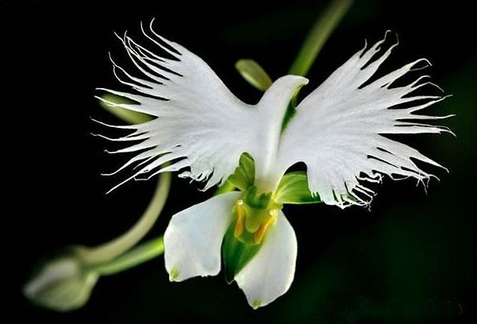
Welcome to St. Luke’s Parish Lalor
‘Please respect the silence of those who pray’

Slide 2
ENTRANCE SONGS

Slide 3
C: In the name of the Father, and of the Son and of the Holy Spirit.
A: Amen
C: The grace of our Lord Jesus Christ, and the love of God, and the communion of the Holy Spirit be with you all.
A: And with your Spirit

Slide 4
PENITENTIAL ACT
I confess to Almighty God
And to you, my brothers and sisters,
That I have greatly sinned, in my
thoughts and
in my words, In what I have done and in what have failed to do,
Through my fault, through my fault,
Through my most grievous fault;
1 of 2

Slide 5
2 of 2
Therefore I ask blessed Mary ever Virgin,
All the Angels and Saints,
And you, my brothers and sisters,
To pray for me to the Lord our God.

Slide 6
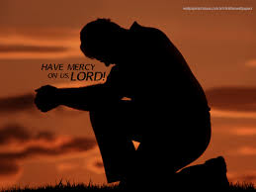
C- Lord have mercy
A- Lord have mercy
C - Christ have mercy
A - Christ have mercy
C- Lord have mercy
A- Lord have mercy

Slide 7
1 of 3
GLORY TO GOD
Glory to God in the highest
And on earth peace to people of good will
We praise You, we bless You,
We adore You, we glorify You,
We give You thanks for Your great glory.
Lord God heavenly King,
O God almighty Father.

Slide 8
2 of 3
Lord Jesus Christ, Only Begotten Son.
Lord God, Lamb of God, Son of the Father,
you take away the sins of the world,
Have mercy on us;
you take away the sins of the world,
receive our prayer;

Slide 9
3 of 3
You are seated at the right hand of the Father,
Have mercy on us.
For You alone are the Holy One,
You alone are the Lord,
You alone are the Most High, Jesus Christ,
with the Holy Spirit, in the glory of God the Father. Amen….

Slide 10
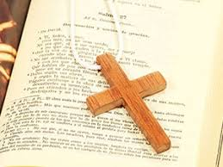

Slide 11
1 of 3
Liturgy of the Word
First Reading Dt 8:2-3. 14-16
A reading from the book of Deuteronomy
Moses said to the people: ‘Remember how the Lord your God led you for forty years in the wilderness, to humble you, to test you and know your inmost heart – whether you would keep his commandments or not. He humbled you, he made you feel hunger, he fed you with manna which neither you nor your fathers had known,

Slide 12
2 of 3
to make you understand that man does not live on bread alone but that man lives on everything that comes from the mouth of the Lord.
‘Do not then forget the Lord your God who brought you out of the land of Egypt, out of the house of slavery: who guided you through this vast and dreadful wilderness, a land of fiery serpents, scorpions, thirst;

Slide 13
3 of 3
who in this waterless place brought you water from the hardest rock; who in this wilderness fed you with manna that your fathers had not known.
The Word of the Lord.
A: Thanks be to God

Slide 14
1 of 2
Responsorial Psalm
PsalmPs 91:2-3. 13-16.
(R.) Praise the Lord, Jerusalem.
1. O praise the Lord, Jerusalem! Zion, praise your God! He has strengthened the bars of your gates, he has blessed the children within you. (R.)

Slide 15
2 of 2
(R.) Praise the Lord, Jerusalem.
2. He has established peace on your borders, he feeds you with finest wheat. He sends out his word to the earth and swiftly runs his command. (R.)
3. He makes his word known to Jacob, to Israel his laws and decrees. He has not dealt thus with other nations; he has not taught them his decrees. (R.)

Slide 16
Second ReadingA reading from the
first letter of St Paul to the Corinthians
1 Cor 10:16-17
1 of 2
The blessing-cup that we bless is a communion with the blood of Christ, and the bread that we break is a communion with the body of Christ. The fact that there is only one loaf means that, though there are many of us, we form a single body because we all have a share in this one loaf.
The Word of the Lord.
A: Thanks be to God

Slide 17
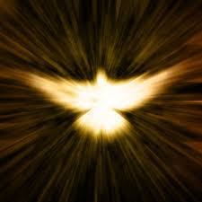
Gospel Acclamation
Alleluia, alleluia!
I am the living bread from heaven, says the Lord; whoever eats this bread will live for ever.
Alleluia

Slide 18
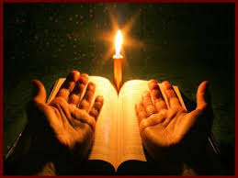
C: The Lord be with you.
A: And with your spirit
C: A reading from the holy Gospel according to :John
A: Glory to you Lord

Slide 19
1 of 2
Gospel : Jn 6:51-58
Jesus said to the Jews: ‘I am the living bread which has come down from heaven. Anyone who eats this bread will live for ever; and the bread that I shall give is my flesh, for the life of the world.’Then the Jews started arguing with one another: ‘How can this man give us his flesh to eat?’ they said. Jesus replied

Slide 20
2 of 2
I tell you most solemnly, if you do not eat the flesh of the Son of Man and drink his blood, you will not have life in you. Anyone who does eat my flesh and drink my blood has eternal life, and I shall raise him up on the last day. For my flesh is real food and my blood is real drink.

Slide 21
2 of 2
He who eats my flesh and drinks my blood lives in me and I live in him. As I, who am sent by the living Father, myself draw life from the Father, so whoever eats me will draw life from me. This is the bread come down from heaven; not like the bread our ancestors ate: they are dead, but anyone who eats this bread will live for ever.’
The Gospel of the Lord.
Praise to you,Lord Jesus Christ

Slide 22
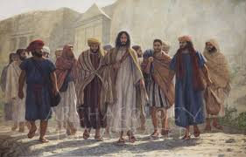

Slide 23
1 of 3
Nicene Creed
I believe in one God,
the Father almighty,
maker of heaven and earth,
of all things visible and invisible.
I believe in one Lord, Jesus Christ,
the Only Begotten Son of God,
born of the Father before all ages.
God from God, Light from Light,
true God from true God,
begotten, not made, consubstantial with the Father; through Him all things were made.

Slide 24
2 of 3
For us men and for our salvation.
He came down from heaven,
and by the Holy Spirit was incarnate of the Virgin Mary, and became man.
For our sake He was crucified under Pontius Pilate,
He suffered death and was buried,
and rose again on the third day
In accordance with the Scriptures.
He ascended into heaven
and is seated at the right hand of the Father.

Slide 25
He will come again in glory
to judge the living and the dead, and His Kingdom will have no end.
I believe in the Holy Spirit, the Lord, the giver of life,
who proceeds from the Father and the Son, who with the Father and the Son is adored and glorified,
who has spoken through the prophets.
I believe in one, Holy, Catholic and Apostolic Church. I confess one Baptism for the forgiveness of sins and I look forward to the resurrection of the dead, and the life of the world to come. Amen.

Slide 26
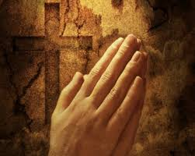
Reader: We pray for…
Let us pray to the Lord.
People: Lord hear our prayer.

Slide 27
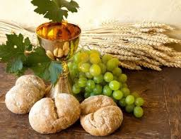

Slide 28
OFFERTORY SONGS

Slide 29
The Liturgy of the Eucharist
C: Pray, brethren that my sacrifice and yours may be acceptable to God, the almighty Father.
A: May the Lord accept the sacrifice at your hands for the praise and glory of his name, for our good the good of all his holy Church. Amen.

Slide 30
The Eucharistic Prayer
C: The Lord be with you.
A: And with your spirit.
C: Lift up your hearts.
A: Lift them up to the Lord.
C: Let us give thanks to the Lord our God.
A: It is right and just.

Slide 31
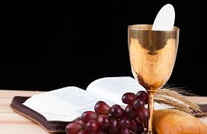

Slide 32
SANCTUS
Holy, holy, holy Lord God of hosts.
Heaven and earth are full of your glory
Hosanna in the highest,
blessed is he who comes in the name of the Lord Hosanna in the highest…

Slide 33
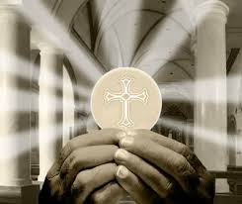

Slide 34
MYSTERY OF FAITH
We proclaim your death O Lord
And profess your resurrection
Until you come again…

Slide 36
1 of 2
LORD’S PRAYER
Our Father, who art in heaven
Hallowed be Thy name.
Thy Kingdom come, Thy will be done
On earth as it is in Heaven
Give us this day our daily bread.
And forgive us our trespasses,
as we forgive those who trespass against us,
And lead us not into temptation,
But deliver us from evil.

Slide 37
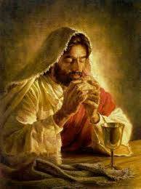
2 of 2
For thy Kingdom, the Power and the Glory are Yours
Now and forever.

Slide 38
C: Lord Jesus Christ, who said to your Apostles…..
….Who live and reign for ever and ever
A: Amen
C: The peace of the Lord be with you always.
A: And with your spirit.

Slide 40
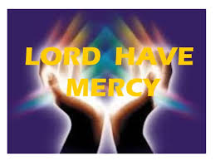
Lamb of God
Lamb of God, you take away the sins of the world,
Have mercy on us.
Lamb of God, you take away the sins of the world,
Have mercy on us.
Lamb of God, you take away the sins of the world,
Grant us peace…

Slide 41
C: Behold the Lamb of God, behold him who takes away the sins of the world. Blessed are those called to the supper of the lamb.
A: Lord, I am not worthy that you should enter under my roof, but only say the word and my soul shall be healed.

Slide 42
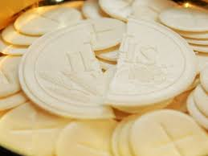

Slide 43
COMMUNION SONGS

Slide 45
CONCLUDING RITES
C: The Lord be with you.
A : And with your spirit
C: May Almighty God Bless Us, Father and Son and Holy Spirit
A: Amen.
C: Go in Peace, glorifying the Lord by your life.
A: Thanks be to God.
.

Slide 46
FINAL SONGS

